Slide 1
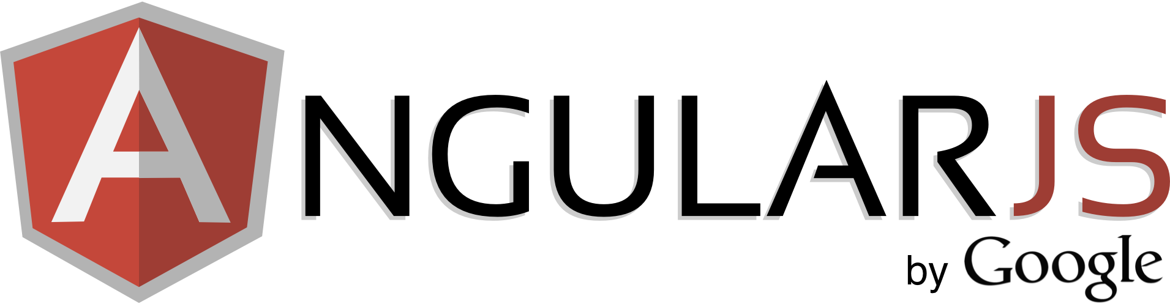
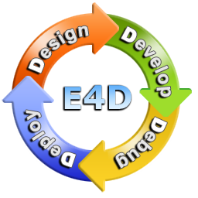


AngularJS Architecture
Eyal Vardi
CEO E4D Solutions LTD Microsoft MVP Visual C# blog: www.eVardi.com

Slide 2
Startup
HTML
Browser
AngularJS
DOM Content Loaded Event
Static DOM
ng-app=“module”
$injector
$compile
$rootScope
Dynamic DOM
(View)
$compile (dom,
$rootScope)

Slide 3
Directive Internal
First the HTML is parsed into DOM using the standard browser API.
$compile()
Once all directives for a given DOM element have been identified they are sorted by priority and their the directive compile() functions are executed.
<div ng-controller="MyCtrl">
<ul>
<li ng-repeat="n in names">{{n}}</li>
</ul>
</div>
DOM + link($scope)
var $compile = ...; // injected into your code
var scope = ...;
var html = '<div ng-bind="exp"></div>';
// Step 1: parse HTML into DOM element
var template = angular.element(html);
// Step 2: compile the template
var linkFn = $compile(template);
// Step 3: link the compiled template with the scope.
linkFn(scope);
Register any listeners on the elements and set up any watches with the scope.
Live binding between the scope and the DOM

Slide 4
Live DOM
Template
<!-- Expressions -->
Please type your name : {{name}}
<!-- Directives & Data Binding -->
Name: <input ng-model="name" value="..." />
Directive
elm.bind('keydown', … )
Binding
Scope
name :
value
$scope.$watch('name', … )

Slide 5
Runtime
During the runtime phase:
Pressing an 'X' key causes the browser to emit a keydown event on the input control.
The input directive captures the change to the input's value and calls $apply("name = 'X';").
Angular applies the name = 'X'; to the model.
The $digest loop begins.
The $watch list detects a change on the name property and notifies, which in turn updates the DOM.
Angular exits the execution context.
The browser re-renders the view with update text.
Native
JavaScript
Event Queue
(wait)
AngularJS
$apply(fn)
fn()
$eval Async queue
Event Loop
$digest loop
DOM Render
$watch list

Slide 6
When The Expression Updated?
When the ngModel is update the Scope is calling to $apply('name=...').
$apply() is used to execute an expression in angular from outside of the angular framework.
// Pseudo-Code of $apply()
function $apply(expr) {
try {
return $eval(expr);
} catch (e) {
$exceptionHandler(e);
} finally {
$root.$digest();
}
}

Slide 7
Observing Model Changes ($watch)
$watch(watchFn, watchAction, deepWatch)
watchFn - This parameter is a string with an Angular expression or a function that returns the current value of the model that you want to watch.
watchAction - This is the function or expression to be called when the watchFn changes.
deepWatch - If set to true, this optional boolean parameter tells Angular to examine each property within the watched object for changes.
...
var dereg = $scope.$watch('Model.Property', callbackOnChange());
…
// de-register $watch
dereg();

Slide 8
Scope's $digest() method
Processes all of the watchers of the current scope and its children.
Because a watcher's listener can change the model, the $digest() keeps calling the watchers until no more listeners are firing.
This means that it is possible to get into an infinite loop. This function will throw 'Maximum iteration limit exceeded.' if the number of iterations exceeds 10.

Slide 9
Scope's $digest() method
scope.name = 'misko';
scope.counter = 0;
Counter = 0
Counter = 1
scope.$watch('name', function(newValue, oldValue) {
scope.counter = scope.counter + 1;
});
scope.$digest();
scope.name = 'adam';
scope.$digest();

Slide 10
Communication

Slide 11
Communication Between Controllers
Root Scope $on(eventName)
$broadcast
Scope $on(eventName)
Scope $on(eventName)
Scope $on(eventName)
$emit

Slide 12

Communication Between Controllers

Slide 13
Scope
Scope Type
Properties:
$id
Events:
$destroy
Lifecycle Methods
$destroy()
$new(isolate)
Communication Methods:
$broadcast(name, args)
$emit(name, args)
$on(name, listener)
Runtime Methods:
$watch(…)
$apply(exp)
$digest()
$eval(exp)
$evalAsync(exp)

Slide 14
Module API

Slide 15
Module API
run(initializationFn)
Use this method to register work which should be performed when the injector is done loading all modules.
Config
- config(configFn)
Registration
- controller(name, constructor)
- directive(name, directiveFactory)
- filter(name, filterFactory)
Registration
- service(name, constructor)
- factory(name, providerFn)
- provider(name, providerType)
- constant(name, object)
- value(name, object)

Slide 16
Modules Load Cycle
angular.module('myApp', ['ngXXX', 'ngYYY']);
ngXXX module
ngYYY module
myApp
Providers
Providers
Providers
Constant
Constant
Constant
Config
Config
Config
Run
Run
Run

Slide 17
Loading and Dependencies
The Config Block
Registers all the providers in this phase.
Only providers and constants can be injected into Config blocks.
Services that may or may not have been initialized cannot be injected.
The Run Block
Run blocks are used to kickstart your application, and start executing after the injector is finished creating.
Only instances and constants can be injected into Run blocks.

Slide 18
Injector

Slide 19
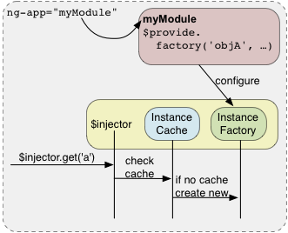
Modules and the Injector
There is a single injector per Angular application.
The injector provides a way to look up an object instance by its name.
The injector keeps an internal cache of all objects so that repeated calls to get the same object name result in the same instance.
If the object does not exist, then the injector asks the instance factory to create a new instance.

Slide 20
Sample Code
// Create a module
var myModule = angular.module('myModule', [])
// Configure the injector
myModule.factory('serviceA', function () {
return {
// instead of {}, put your object creation here
};
});
// create an injector and configure it from 'myModule'
var $injector = angular.injector(['myModule']);
// retrieve an object from the injector by name
var serviceA = $injector.get('serviceA');
// always true because of instance cache
$injector.get('serviceA') === $injector.get('serviceA');

Slide 21
The Real Magic of The Injector
// You write functions such as this one.
function doSomething(serviceA, serviceB) {
// do something here.
}
// Angular provides the injector for your application
var $injector = ...;
///////////////////////////////////////////////
// the old-school way of getting dependencies.
var serviceA = $injector.get('serviceA');
var serviceB = $injector.get('serviceB');
// now call the function
doSomething(serviceA, serviceB);
///////////////////////////////////////////////
// the cool way of getting dependencies.
// the $injector will supply the arguments to the function automatically
// This is how the framework calls your functions
$injector.invoke(doSomething)

Slide 22
Thanks
eyalvardi.wordpress.com
Eyal Vardi
CEO E4D Solutions LTD Microsoft MVP Visual C# blog: www.e4d.co.il

